Slide 1


<Name>
<Date>

Slide 2

Outline
Executive Summary
Introduction
Methodology
Results
Conclusion
Appendix

Slide 3
Executive Summary
Summary of methodologies
Data Collection using API calls and Web-scrapping.
Data Wrangling.
Use SQL and visuals to conduct Exploratory Data Analysis.
Folium used to make highly interactive map of launch sites.
Plotly Dash to build Dashboard for deeper analysis of data.
Predictive Model to predict landing success of failure of Falcon 9 First Stage.
Summary of all results
Data Visuals and Interactive Dashboards
Predictive Model Results

Slide 4
Introduction
Project background and context
Due to successes of space companies such as SpaceX, the Space Industry is experiencing a boom in popularity and investment. The main bottleneck holding startups back from entering this industry is the Cost of Launch to put a payload in orbit.
SpaceX has had significant success reusing their First Stage. This has allowed spaceX to perform launches for the price of $62,000,000 compared to competitors which are offering launches at around $165,000,000.
Problems you want to find answers
Can we tell if the First Stage of a Falcon 9 launch will land successfully?
What are the major variables and their effect on landing outcomes?

Slide 5

Section 1

Slide 6
Data Collection
Data Collection was performed using both official SpaceX provided APIs as well as web scrapping publicly available information on Wikipedia.
SpaceX API
Web-scrapping
API Request
Read API Response
Preliminary Data Wrangling
Convert to CSV Format
Request launch data using SpaceX API
Read .JSON and convert into a DataFrame
Extract relevant data fields.
to_csv()
Perform HTTP GET
Create BeautifulSoup
Extract Data to Dataframe
Convert to CSV Format
Request Falcon 9 webpage using the HTTP get method.
Create object from HTML Response using Beautiful Soup
Collect relevant headers and extract rows to Dafa Frame.
To_csv()

Slide 7
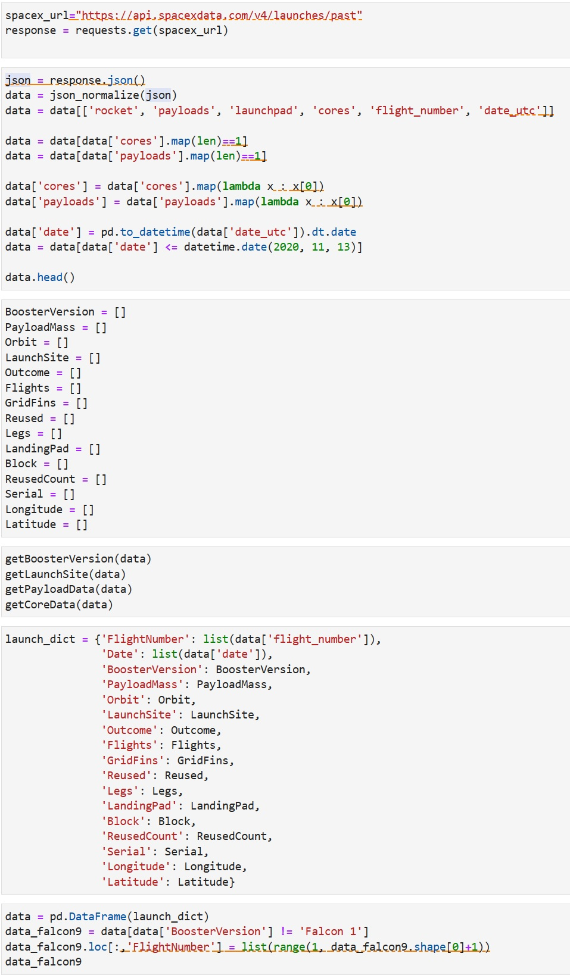
Data Collection – SpaceX API
API Request and Read Response into Data Frame
Declare Global Variables. These will store data returned by helper functions.

Slide 8
Data Collection – SpaceX API
Call helper functions to populate global variables.
Construct data using dictionary.
Convert dictionary into data frame, filter for Falcon 9 launches, and convert to CSV.

Slide 9
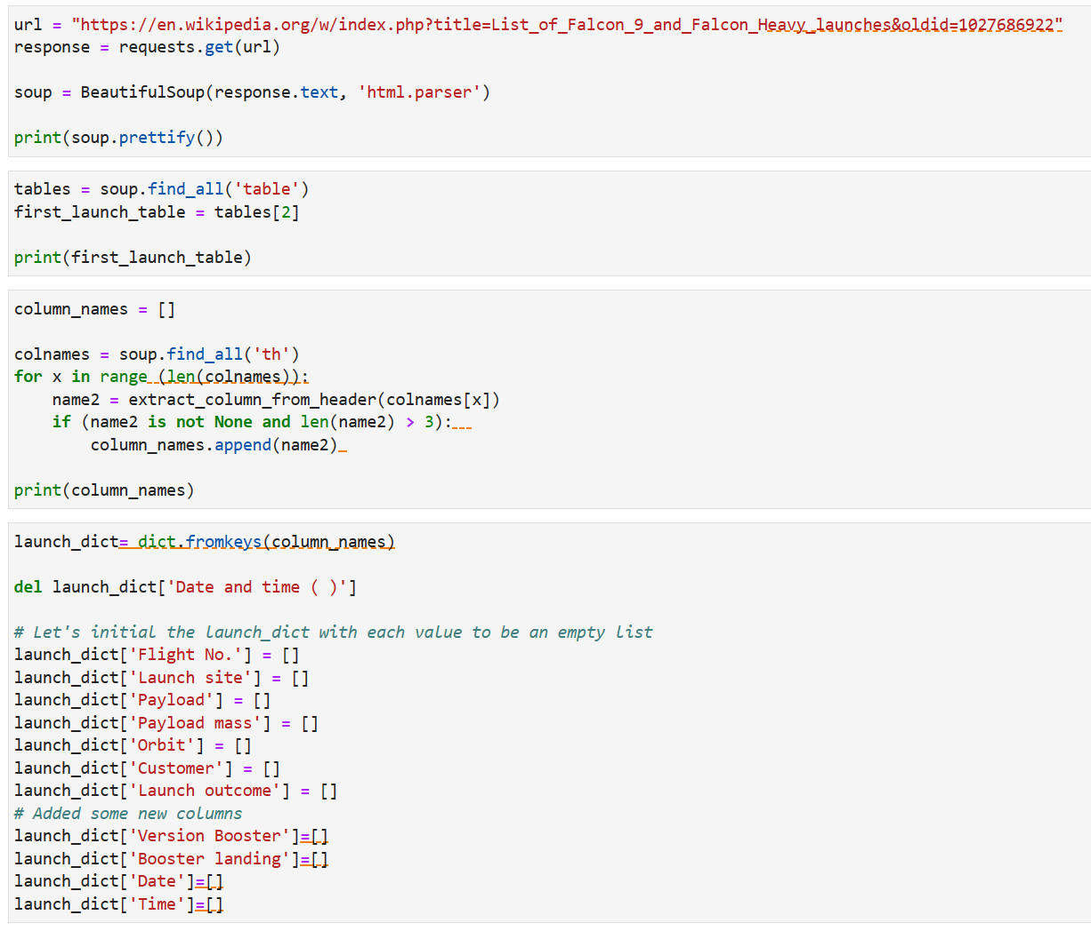
Data Collection - Scraping
Create HTTP GET method and request Falcon 9 launch webpage.
Create Beautiful soup object.
Find all Tables on the wiki page and extract column names from table headers.
Create dictionary with keys from extracted column names.

Slide 10
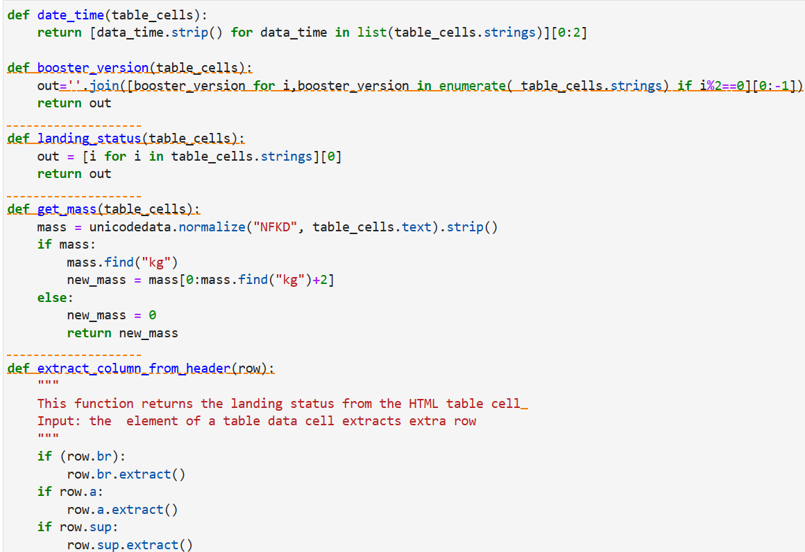
Data Collection - Scraping
Call helper functions to fill up dictionary with records of launches
Convert dictionary to dataframe and then use to_csv() to extract the data as a CSV.

Slide 11
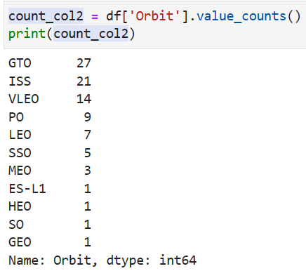
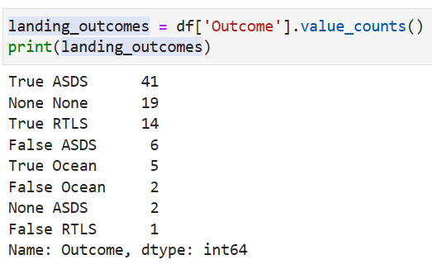
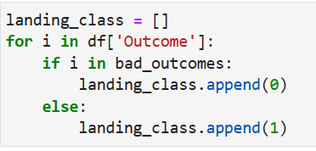
Data Wrangling
Load Dataset in as a Data Frame.
Find patterns that are relevant to the problem being solved.
Create a landing outcome label.

Slide 12
EDA with Data Visualization
Scatter Plot:
Payload Mass vs. Flight Number
Launch Site vs. Flight Number
Payload Mass vs. Launch Site
Flight Number vs. Orbit Type
Payload vs. Orbit Type
Bar Graph
Orbit Type vs. Success Rate
Line Chart
Year vs. Success Rate

Slide 13
EDA with SQL
Displayed names of the unique launch sites.
Displayed 5 records where launch sites began with the string ‘CCA’.
Displayed total payload mass carries by boosters launched by NASA.
Displayed average payload mass carried by booster version F9 v1.1
List the date when the first successful landing outome on ground pad was achieved.
List the names of the boosters which have success in drone ship and have payload mass greater than 4000 but less than 6000.
Listed total number of failure and success outcomes.
Listed names of booster versions which have caried maximum payload mass.
Ranked the count of landing outcomes between the date 6/4/2010 and 3/20/2017.

Slide 14
Build an Interactive Map with Folium
Markers for all launch sites on the map.
Folium.circle and folium.marker to highlight launch sites.
MarkerCluster() to show success (green) and failure (red) for each launch site.
Calculated distances between launch site and its proximities (Coast, Railroad, Highway, City)
MousePosition() to get coordinate for mouse position over map.
Folium.Marker() to show distance in KM on the map.
Folium.Polyline() to draw line between launch site and each proximity.

Slide 15
Build a Dashboard with Plotly Dash
Built Plotly Dash application to perform interactive visual analysis on SpaceX launch data.
Added Launch site drop-down input component to dashboard to filter data by launch site.
Added Pie chart to dashboard to show successes and failures of each launch site.
Added Payload range slider to easily select different payload ranges to identify patterns.
Added scatter plot to observe payloads correlation with launch outcomes for selected sites.

Slide 16
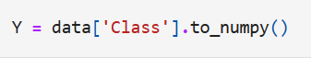
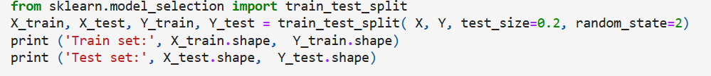
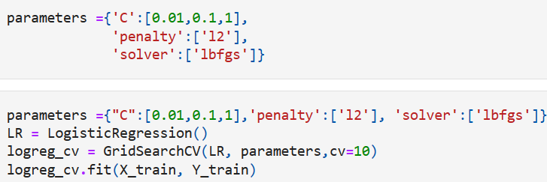
Predictive Analysis (Classification)
Load SpaceX dataset to Data Frame and crease NumPy array from column class in Data.
Normalized Data in X and reassigned to variable using transform.
Train/Test/Split X and Y into training and test sets.
Created and refined models using following classification algorithms.
Logistic Regression
Grid Search
Displaying hyperparameters and accuracy score.

Slide 17
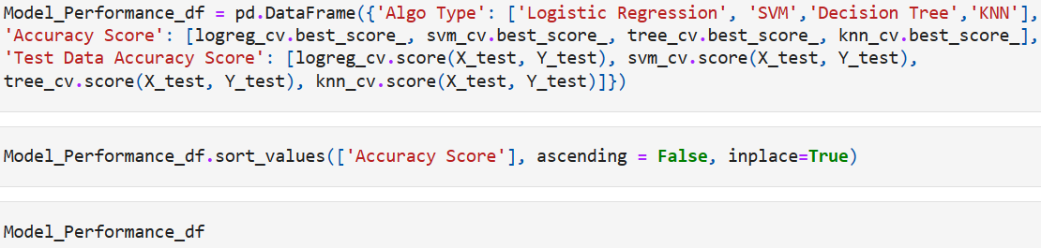
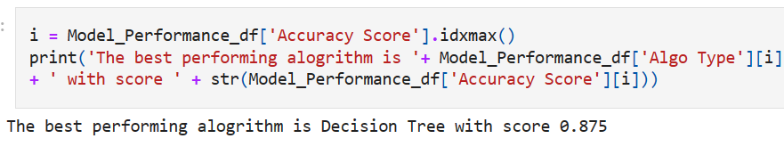
Predictive Analysis (Classification)
Find the best performing model.

Slide 18
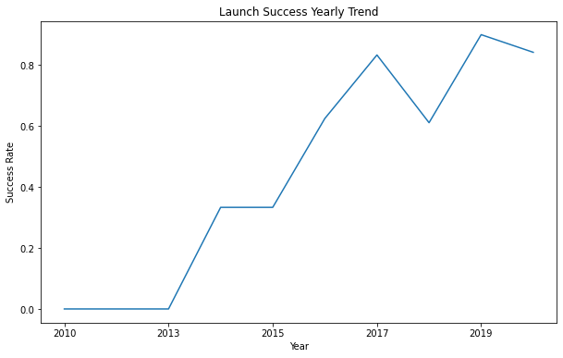
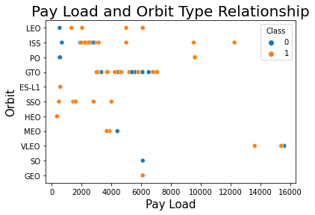
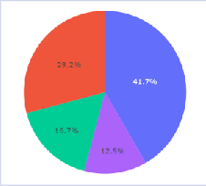
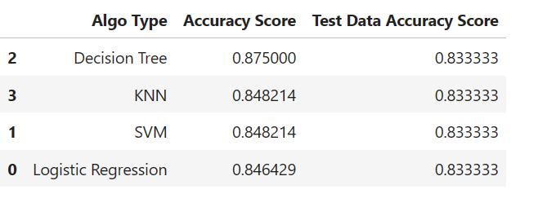
Results
Exploratory data analysis results
Interactive analytics demo in screenshots
Predictive analysis results

Slide 19

Section 2

Slide 20
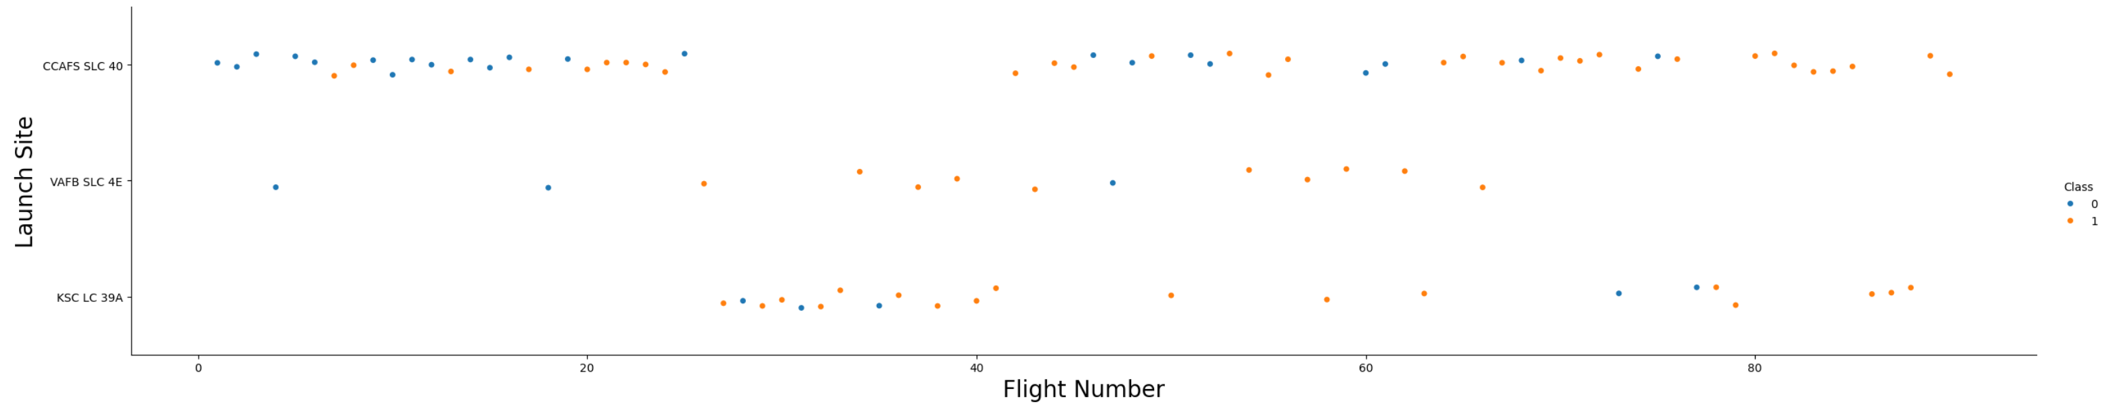
Flight Number vs. Launch Site
As Flight Number increases so do successes (Class 1 – Orange)
Launch site KSC LC 39A was not used in any initial launches and it took 26 attempts before a launch was done there.

Slide 21
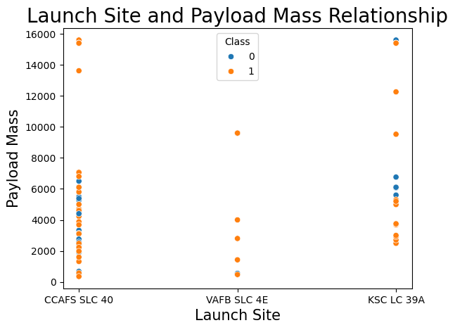
Payload vs. Launch Site
There are no rockets launched with a payload greater than 10,000 kg at launch site VAFB SLC 4E.
Payloads above 8500 kg and below 10000 kg tend to be attempted at VAFB SLC 4E launch site.
There are no clear correlations between the other 2 launch sites and payload mass.

Slide 22
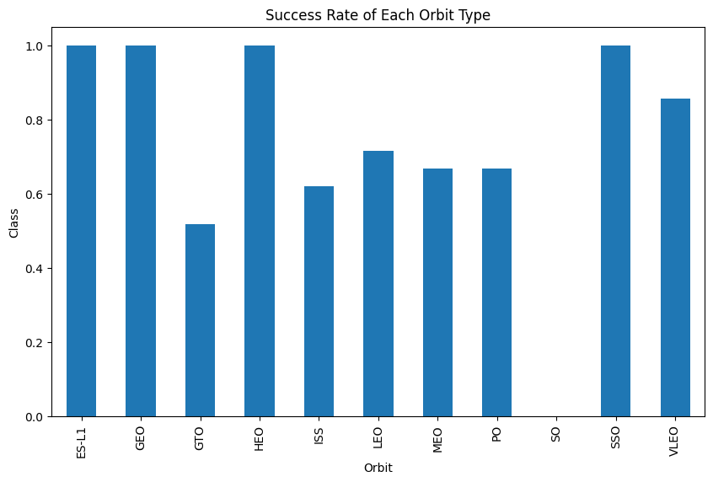
Success Rate vs. Orbit Type
ES-LI, GEO, HEO, and SSO have highest success rates.
GTO has lowest.

Slide 23
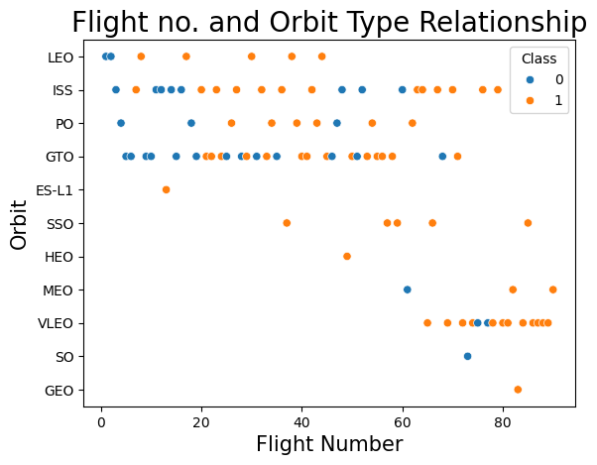
Flight Number vs. Orbit Type
First successful landing of VLEO doesn’t occur until around 63rd flight.
For most orbits (excluding VLEO) successful landing attempts increase with flight number.

Slide 24
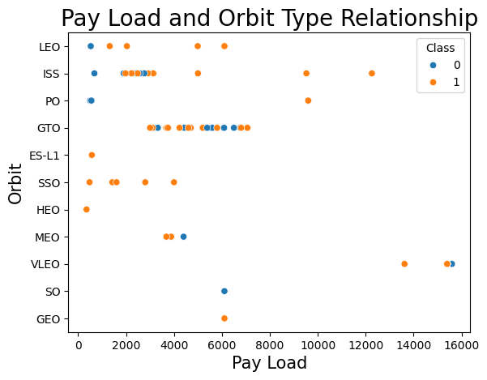
Payload vs. Orbit Type
Show a scatter point of payload vs. orbit type
Show the screenshot of the scatter plot with explanations

Slide 25
Launch Success Yearly Trend
Show a line chart of yearly average success rate
Show the screenshot of the scatter plot with explanations

Slide 26
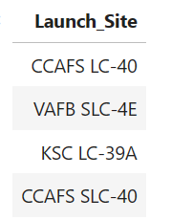
All Launch Site Names
Query
Distinct returns only unique values from the Launch_Site column.
Result

Slide 27
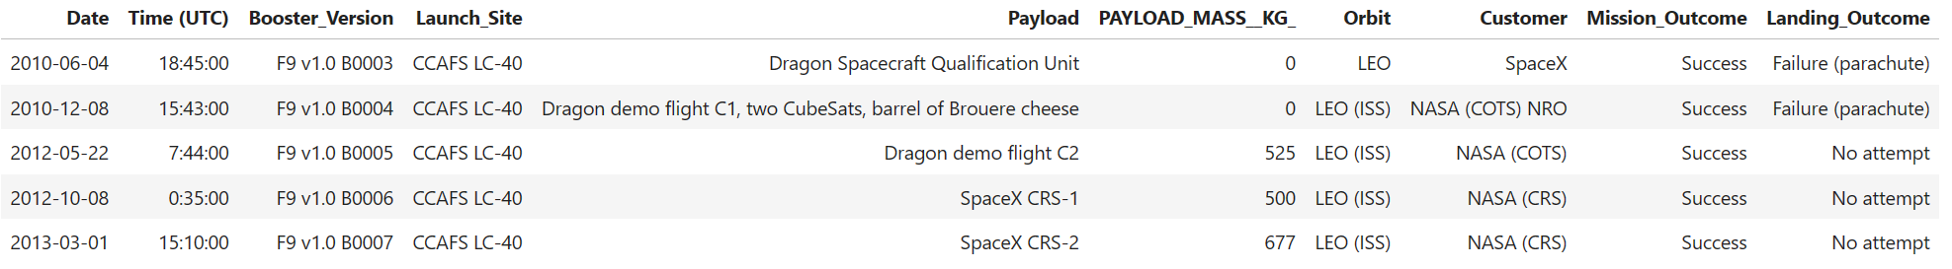
Launch Site Names Begin with 'CCA'
Query:
Like ‘CCA%’ returns any results with CCA in the string. Limit 5 ensures that only 5 results are returned.
Result:

Slide 28
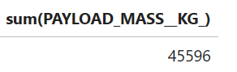
Total Payload Mass
Query:
Where Customer =‘NASA (CRS)’ added to the end of the query selects only rows that have NASA as a customer.
Sum(PAYLOAD_MASS_KG_) sums up all values in this column that meet the criteria specified by the where operation.
Results:

Slide 29
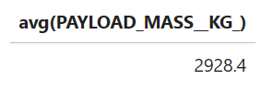
Average Payload Mass by F9 v1.1
QUERY:
WHERE Booster_Version LIKE ‘F9 v1.1’ added at the end returns only values in the Booster_Version column that have the string F9 v1.1 in them.
Avg(PAYLOAD_MASS_KG_) averages every value that meets the criteria specified using the where operation.
RESULTS:

Slide 30
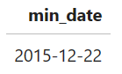
First Successful Ground Landing Date
QUERY:
Min(Date) as min_date searches for the lowest value in the date column and returns it under the header min_date.
RESULT:

Slide 31
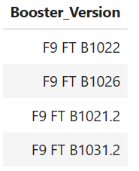
Successful Drone Ship Landing with Payload between 4000 and 6000
QUERY:
And operation allows the querying of data based on several conditions. In this case that (PAYLOAD_MASS_KG_ > 4000 and PAYLOAD_MASS_KG_ < 6000) as well as the Landing_Outcome column having a value of Success (drone ship)
RESULTS:

Slide 32
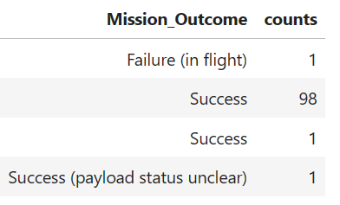
Total Number of Successful and Failure Mission Outcomes
QUERY:
Group by Mission_Outcome consolidates all of the data by distinct values in the Mission_Outcome column
Count(Mission_Outcome) as counts returns a new column of the quantity of each mission outcome type.
RESULTS:

Slide 33
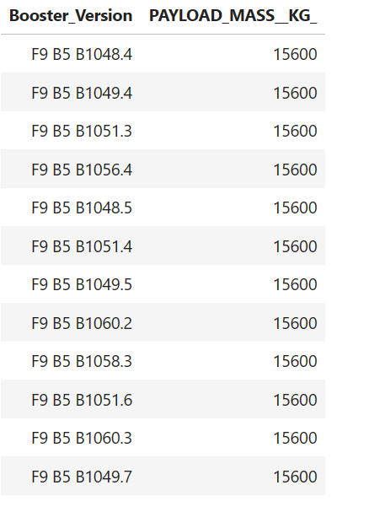
Boosters Carried Maximum Payload
QUERY:
RESULTS:
Where PAYLOAD_MASS_KG = Select max(PAYLOAD_MASS_KG_) returns only rows where the payload mass is equal to the maximum PAYLOAD_MASS_KG_ value present within the dataset.
In this case the maximum payload mass carried by any Booster Version is 15600 KG

Slide 34
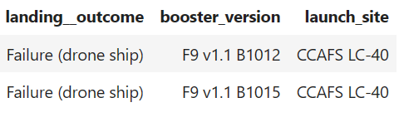
2015 Launch Records
QUERY:
RESULT:

Slide 35
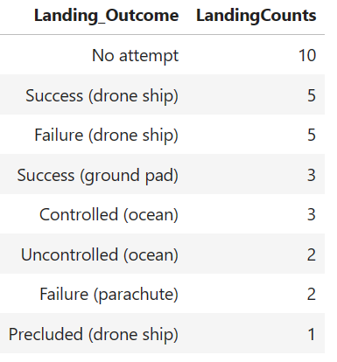
Rank Landing Outcomes Between 2010-06-04 and 2017-03-20
QUERY:
Order by count(*) desc; arranges all of the query results based on tallying up the Landing Outcomes and displaying them in descending order of quantity.
RESULTS:

Slide 36

Section 3

Slide 37
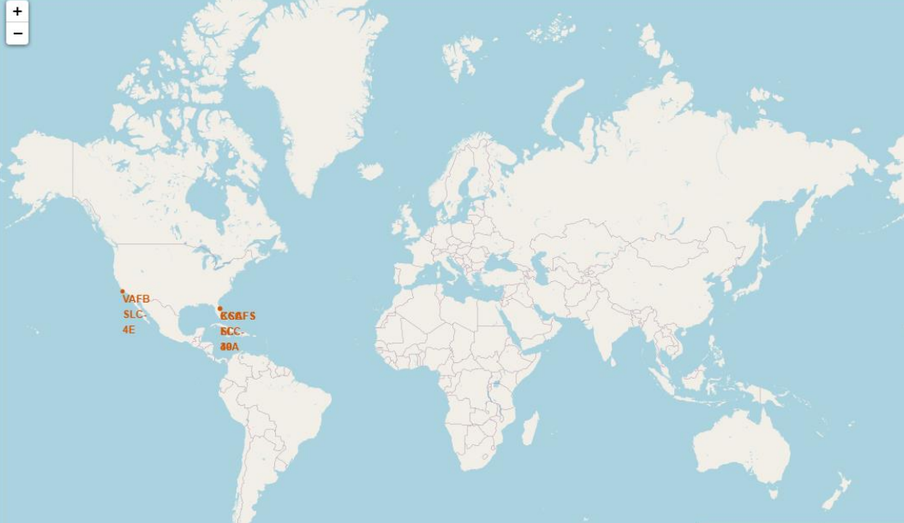
SpaceX Falcon 9 – Launch Sites Map
SpaceX has 4 total launch sites.
1 is located in California, US
VAFB SLC-4E
3 are located in Florida, US
KSC LC-39A
CCAFS LC40
CCAFS SLC-40

Slide 38
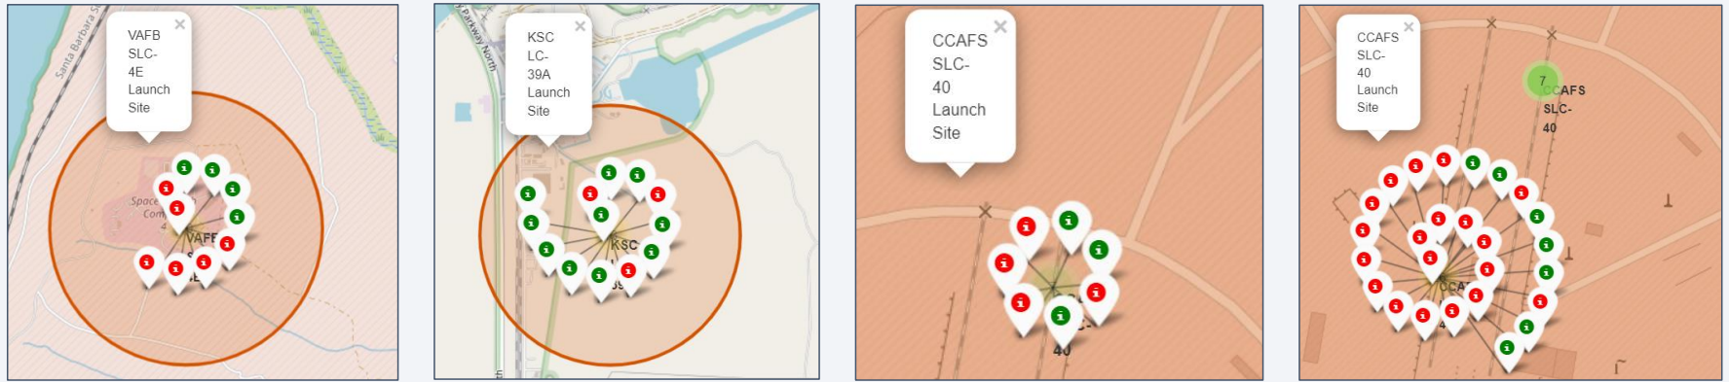
<Folium Map Screenshot 2>

Slide 39
<Folium Map Screenshot 3>
Replace <Folium map screenshot 3> title with an appropriate title
Explore the generated folium map and show the screenshot of a selected launch site to its proximities such as railway, highway, coastline, with distance calculated and displayed
Explain the important elements and findings on the screenshot

Slide 40

Section 5

Slide 41
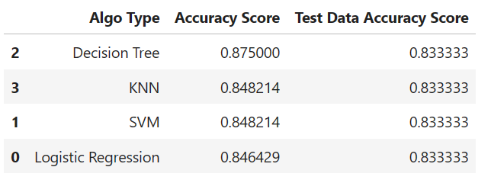
Classification Accuracy
By looking at the accuracy scores it is evident that Decision tree was the most accurate predictive model.
There was no difference between testing accuracy on any model. (all = 0.833)

Slide 42
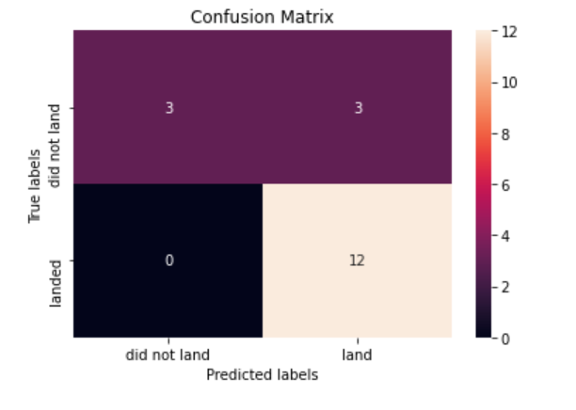
Confusion Matrix
18 Predictions made.
All models had same confusion matrix.
12 predicted yes for landing.
3 predicted no for landing but did successfully land.
3 predicted yes for landing that did not land successfully.
Error rate = 16.5%

Slide 43
Conclusions
As time goes on and more attempts are made (and presumably learned from) the rate of success on relanding the first stage improves.
There was a marked 80% improvement in success rate from 2013 to 2020.
GTO is the orbit with the lowest success rate.
Launch Sites typically are located on coastal areas closer to the equator.
The Decision Tree was the Machine Learning model with the highest predictive accuracy though with a small sample size it is hard to say for certain that it would be the best approach long term.

Slide 44


